Slide 1
Banqi
Team: ByteMe
Members:
Joshua Henry
Alex Hinterlong
Brian Martin
Stephen Porsche
Evan Salzman

Slide 2
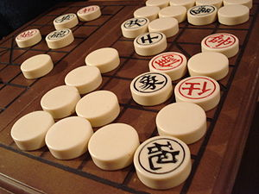
How to play
4x8 game board
32 total pieces
16 per side (red/black)
Pieces randomly placed face down
Based off of rank
General, 1
Advisor, 2
Elephant, 2
Chariot, 2
Horse, 2
Cannon , 2
Soldier, 5

Slide 3
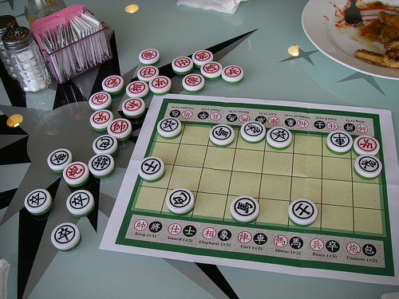
Each player takes turns making a move
A valid move can be either:
Flipping a piece over
Capturing an enemy piece
Moving a piece
Moves can only be up/down/left/right
Host starts first by flipping over any piece
The color of the piece the host turns over is the color of his/her pieces for the game
Capturing only happens to a piece of equal or lesser rank
Exception: General cannot capture soldiers, but soldiers can capture the General
A player loses when they lose all their pieces and can no longer make any moves

Slide 4
Use cases:
Create User Profile
Create new game
Invite Second Player
Respond to Invitation
Play game
Determine Turn
Make Valid Move
View Board Status
Record match history
Forfeit game
View Profile
Get Player history

Slide 5
Use case id: | 1
Extension Case: | Record Match History
Use case name: | Create User Profile
Overview: | Player creates a user profile using an email address, and specifying a nickname to be used during games
Primary Actors: | Any potential player
Secondary Actors: | None
Pre-conditions: | User must have a valid email Nickname must be unique
Main flow: | Use email to create an account Make a password Create a Nickname
Post-conditions: | The player now has a User Profile
Alternative flows: | The player has failed to create a valid profile

Slide 6
Use case id: | 12
Use case name: | Record Match History
Overview: | Segment I: records all matches played by the user.
Primary Actors: | Any player
Secondary Actors: | None
Segment I Pre-conditions: | The user has started a game
Segment I Main flow: | The system detects that a game has started or finished The time that the game starts or ends is recorded If the game has ended, the result is recorded (win, loss, or withdraw) If the game has ended, the total time spent on that game is recorded.
Segment I Post-conditions: | The start time, end time, game result, and total time played for that game have been recorded for the player

